Slide 1

Exploratory Data Analysis on NYC Traffic Accidents
CSE3040 – Final Project Presentation
By Laksharaa A S, Amritha A, Nitish Ram J
Guided by ASNATH VICTY PHAMILA Y | Submitted on 21/04/2025

Slide 2

Abstract
Analyzed NYC traffic accident data
Explored causes, timing, and locations
Time series forecasting for injury trends
Supports UN SDG 3: Good Health & Well-being

Slide 3
Objectives
Analyze accident distribution spatially and temporally
Identify frequent causes and contributors
Assess impacts on pedestrians, cyclists, motorists
Forecast future trends via time series analysis
Suggest accident reduction strategies from data

Slide 4
Tools & Libraries Used
Pandas & NumPy
Matplotlib & Seaborn
Prophet
seasonal_decompose
Data cleaning and manipulation
Time series forecasting
Data visualization
Trend and seasonality analysis

Slide 5
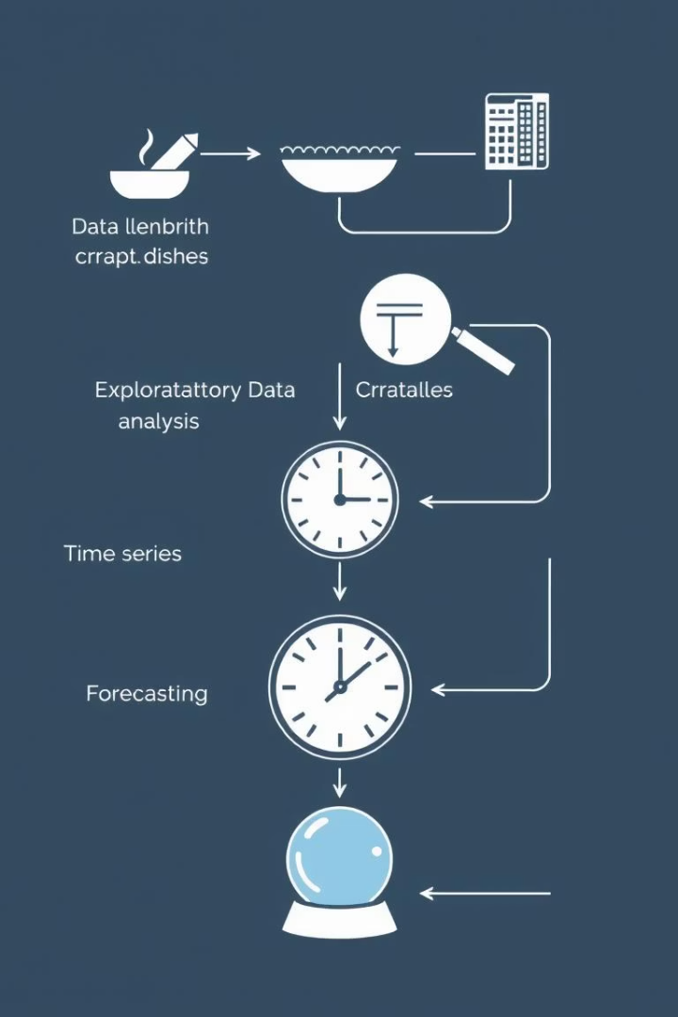




Methodology Overview
Data Cleaning
Missing values handled, datetime indexed
Exploratory Data Analysis
Visualize patterns, identify risks
Time Series Analysis
Daily aggregation, seasonal trends
Forecasting
Prophet model for 30-day prediction

Slide 6

System Architecture
1
Input Layer
NYC traffic dataset (CSV)
2
Processing Layer
Data cleaning, transformation, EDA
3
Modeling Layer
Time series + Prophet modeling
4
Output Layer
Charts, trends, predictions generated

Slide 7
Module Breakdown
Cleaning Module
EDA Module
Time Series Module
Forecasting Module
Replaced nulls and ensured stable data
Explored injury patterns visually
Identified trends and seasonal cycles
Predicted injury counts forward

Slide 8
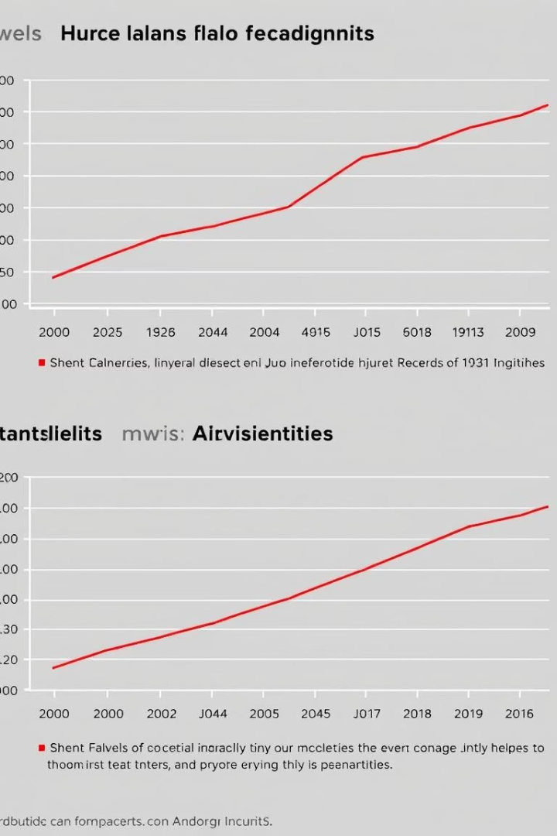
Key Insights from Graphs
Injuries exceed fatalities consistently
Spikes occur during weekends and holidays
High-risk periods repeat weekly
Data shows clear trends with low noise

Slide 9
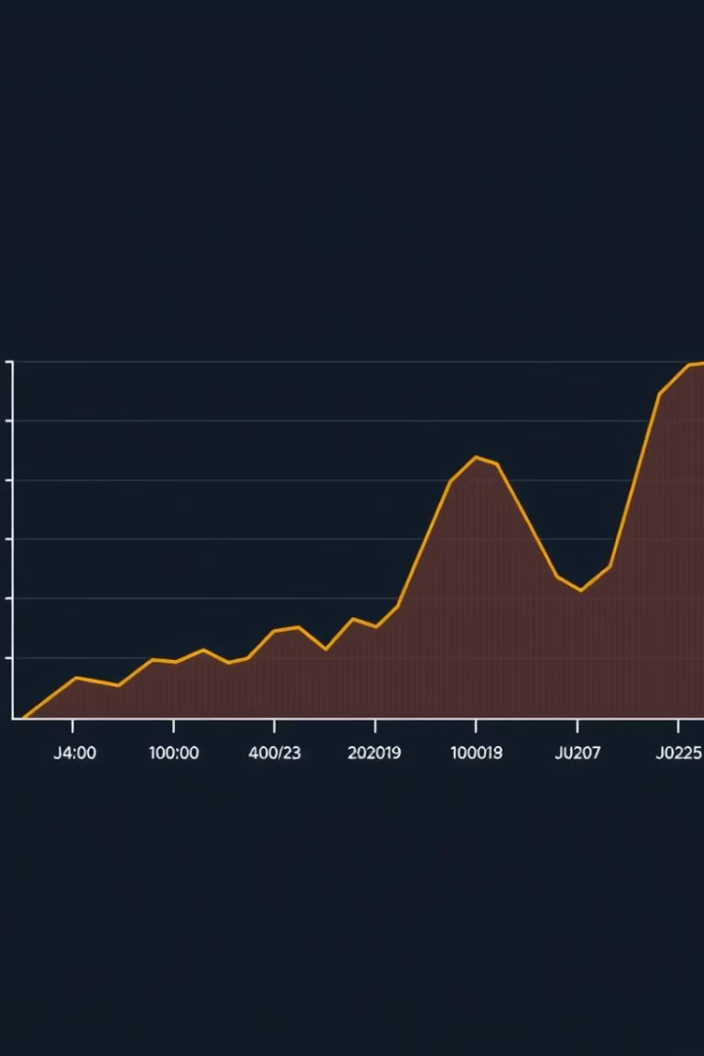
Time Series Forecast (Prophet)
Upward trend in injury forecasts
Weekly spikes on Fridays and weekends
High accuracy short-term, uncertainty grows longer
Supports emergency planning and alerts

Slide 10
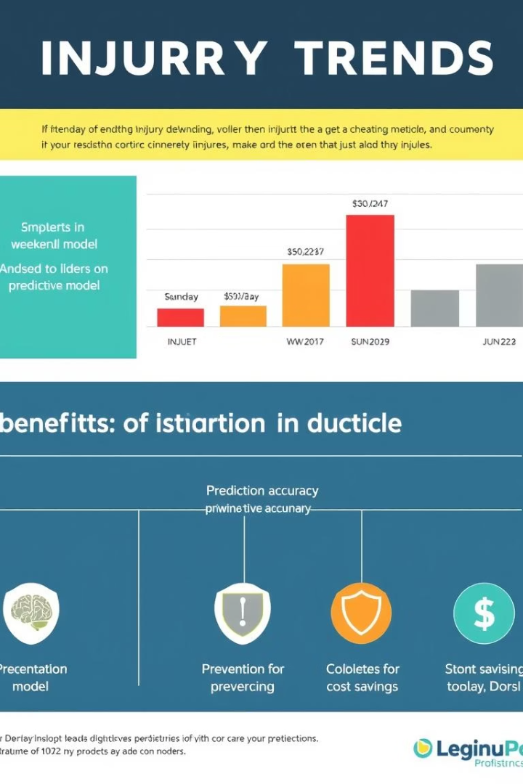
Results Summary
Weekly injury peaks on weekends evident
Long-term increase in injury trends detected
Strong weekly seasonality identified
Reliable model for urban safety planning

Slide 11
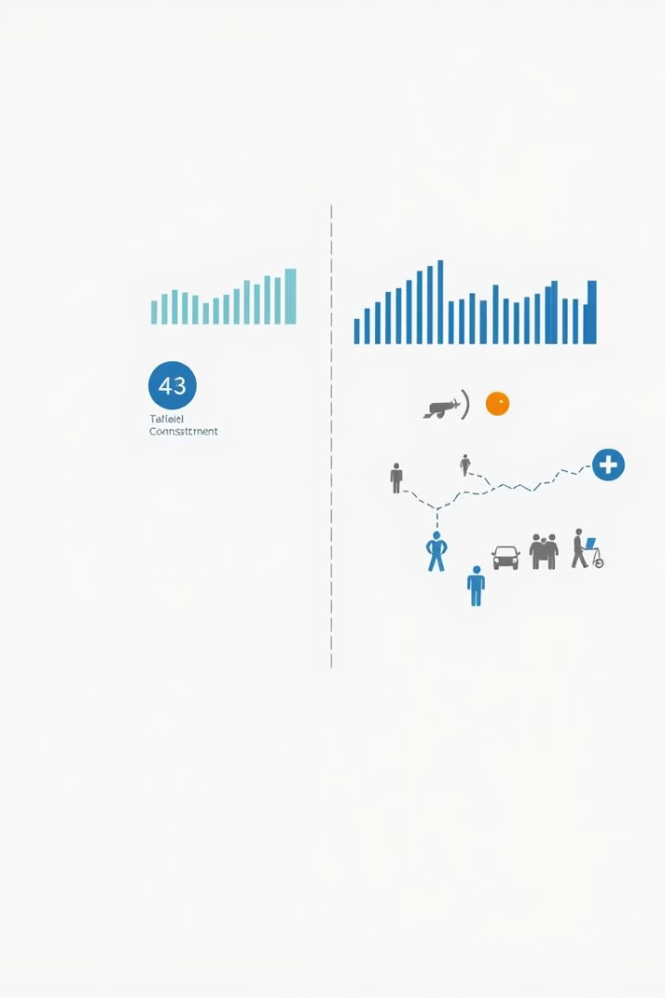
Conclusion
Data-driven approach identifies risks effectively
Insights guide policies & improve road safety
Forecasting prevents future incidents
Supports smarter decisions in health and traffic control

Slide 12
Thank You!

